Slide 1
FNT Structural Explanation
https://github.com/Hongwei00/FishingNetTopology
Hongwei Zhang
Feb 17, 2022

Slide 2
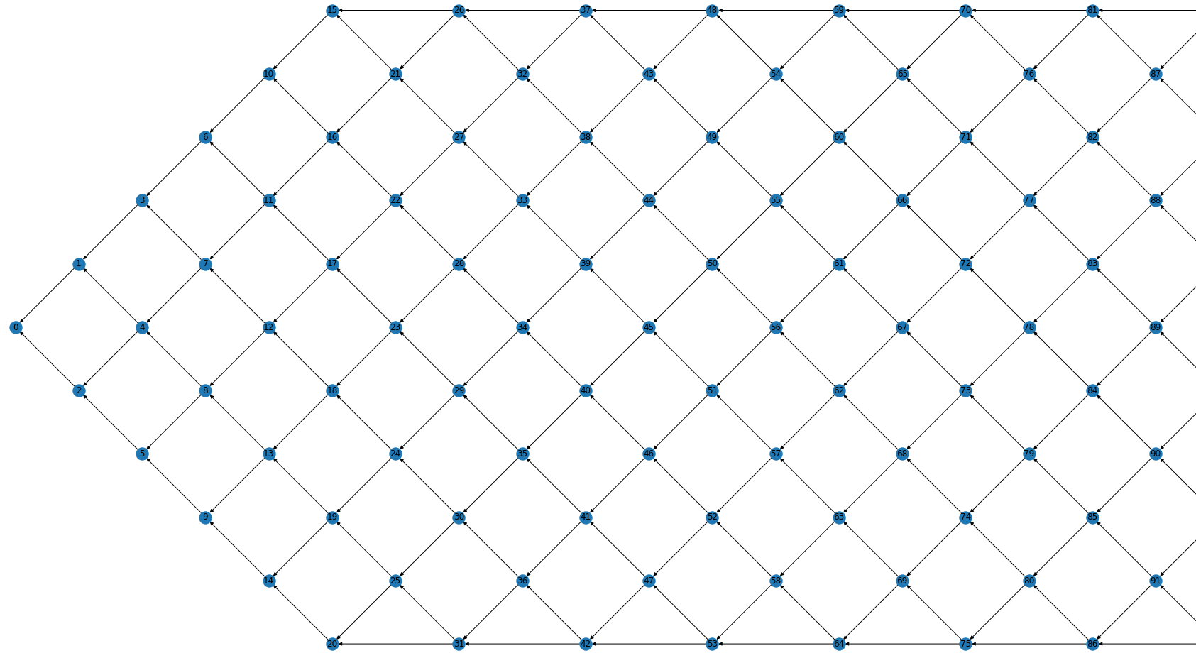
Upper Bound
Initial Network
Group
Rate
Formal Network
Lower Bound

Slide 3
Terminology
Initial Network:
The part that allows the network to progressively reach maximum throughput.
The part used for network initialization, starting from node 0, each column has one more node than the previous one, until the number of nodes reaches the number of Rate.
Form a triangle.
Formal Network:
The formal network, the main part of the FNT.
At this point the network can reach maximum throughput.
The number of nodes in the first column is equal to Rate, and the second column is one smaller than Rate, these two columns form a Group.
The structure of the formal network is the repetition of the Group.
Rate:
The data packet throughput in the network. The maximum number of packets going through the network at the same time.

Slide 4
Rate = 6
Initial Network
Formal Network

Slide 5
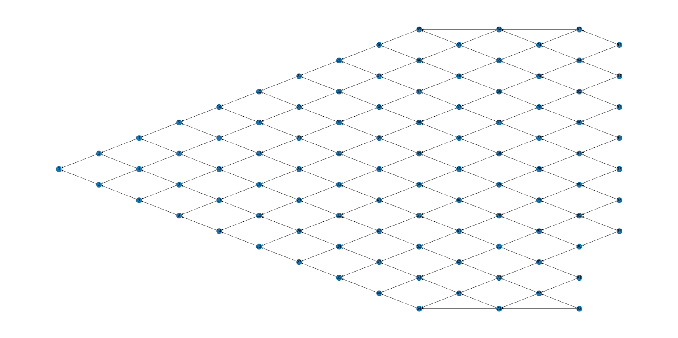
Initial Network
Node 0: No Tips
Nodes on the border have only one Tip
Other nodes have two Tips
All nodes are approved by two nodes

Slide 6
Initial Network
Tip List = [ 0 1 ]
TipList [0]
1
0

Slide 7
Initial Network
Tip List = [ 0 1 2 ]
TipList [0]
1
0
2
TipList [0]

Slide 8
Initial Network
Tip List = [ 1 2 3 ]
TipList [0]
3
1
0
2

Slide 9
Initial Network
Tip List = [ 1 2 3 4 ]
TipList [0]
3
1
0
4
TipList [0]
2

Slide 10
Initial Network
Tip List = [ 2 3 4 ]
3
1
0
4
TipList [0]
2

Slide 11
Initial Network
Tip List = [ 2 3 4 5 ]
3
1
0
4
TipList [0]
2
5
TipList [0]

Slide 12
Initial Network
10
Rate = 5
6
11
3
7
1
12
0
4
8
2
13
5
9
14

Slide 13
Formal Network
The first tip of the node at the boundary needs to connect the column before the previous column
Other nodes only connect the nodes at the previous column
The number of nodes in the first column is equal to the rate
The number of nodes in the second column is 1 less than rate

Slide 14
Formal Network
R1 = Rate = 5
R2 = Rate – 1 = 4
R3 = R1 + R2 = 9
R3 = 9
10
19
R1 = 5
R2 = 4
15
R2 = 4
R1 = 5
11
20
R1 = 5
R2 = 4
16
R2 = 4
R1 = 5
12
21
R1 = 5
R2 = 4
17
R2 = 4
R1 = 5
13
22
R1 = 5
R2 = 4
18
R2 = 4
R1 = 5
14
23
R3 = 9

